Slide 1
MSBD 5013 Project Instruction (Python Version)

Slide 2
Brief description of the project
You are provided with minute-level future data from China futures market, including 10 commodity futures and 3 stock index futures. As time goes by, new data will be sent to you weekly.
You are expected to write a strategy function that can update your position matrix every minute. It receives data of current minute and utilizes data you save in its memory to make decision about how to trade on next minute bar (long/short/close position or do nothing).
All your strategies will be tested weekly under a standard testing program.
You can choose to write your strategy using R or python.

Slide 3
About the files in this dropbox folder
Data:
Information.csv
data_format1_20170717_20170915.h5
data_format2_20170717_20170915.h5
……
Instructions:
R version and Python version
Performance testing program:
backTest.py
Demo folders:
Demo1, demo2, …

Slide 4
Schedule
Preparation period | Regular season | Play-off
Now ~ Oct 22 | Oct 15 ~ Dec 3 (6 weeks) | Dec 4 ~ Dec 24
Team up More than two month historical data will be sent to you as the initial training set. More data will be provided weekly as time goes by You should read the instructions and demos carefully, play with data, then try to write your first strategy | For each week: Teams can upload new strategies before week starts (i.e. midnight of last Sunday) or just keep the old strategies for testing. We will test strategies performance using data from this week (usually 5 trading days) The performance leaderboard will be updated on Sunday After that, new data from this week will be sent to you. You can add them to your training set | With the experience gained from regular season, you should write your “ultimate strategy” and upload it before Dec 17 Along with the code files, you should also upload a pdf report about the details of your strategies, including the methods, rationality, detailed process of data analysis, main result, etc. We will grade your final report and test your strategies’ performance using the data from last week (Dec 18 ~ Dec 24) as the play-off contest

Slide 5
Scale of marks
Final Report |  | 50%
Performance | Regular season | 50%
 | Play-off
Note:
The evaluation of your performance score that counts towards overall grade is based on the BEST weekly performance of your submission.
There are 7 weekly performance testing chance for your team. 6 weeks for regular season and 1 week for the play-off. There will be no penalty if your team do not choose to submit your week in some weeks. But the more weeks you join in, the more chance your team may get a good weekly performance. On the other hand, if your team only submit your work on one or two weeks, your performance score may have a risk of being bad due to occasional issues.
Leader board will be published every week since regular season starts. There will be extra reward for the front-runners of the leader board.

Slide 6
Important! How to upload your strategy
Create a folder whose name is your team name. The folder name should only contain a~z, A~Z, 0~9 and underscore and not be too long. If your team name containing illegal characters (like Chinese characters) or too long, try to use some shorthand, pinyin etc. and report the name to TA.
In this folder, there must have a “strategy.py” file. You can also add other facility files in this folder. See the comments in demos for more information.
Make sure your strategy.py can pass the testing program (backTest.py) without error (You may need to reset the working folder and data path in backTest.py firstly).

Slide 7
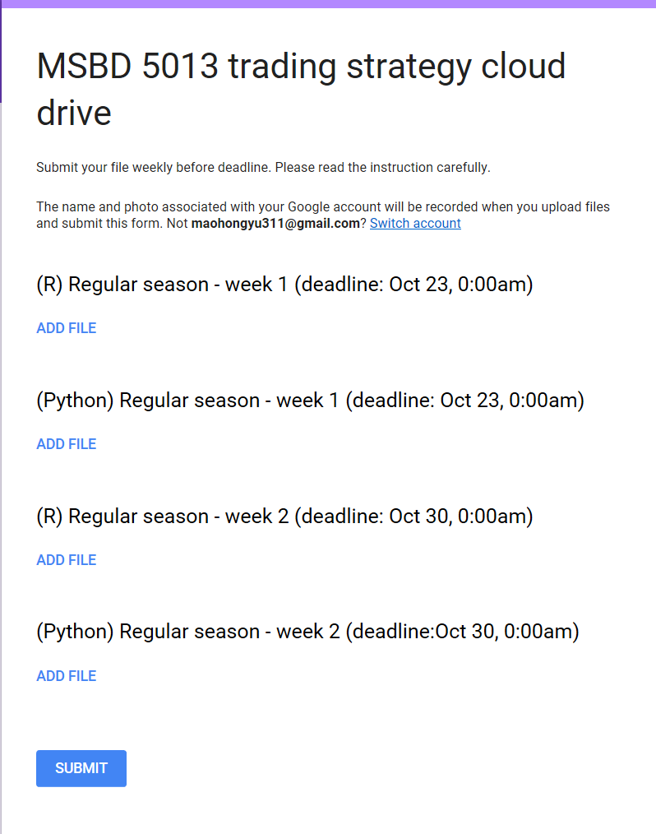
Important! How to upload your strategy
If you feel OK, zip the folder to a .zip file, whose name is also your team name, then upload this zip file to https://docs.google.com/forms/d/1gxm_ZNTJu_bPtY9iVZMyj4qq3VH4X6TiK6QHiXZyKdA (need a google account to upload files)
Choose the proper address to upload your file before deadline. After deadline, all uploaded files will be frozen.
If your team don’t have a new strategy for some weeks, you can also choose to submit your old strategy to new week address.
Don’t forget to click submit
Please submit your files into the right folder(Python or R)

Slide 8
Criterion for evaluation of Final Reports
Presentation skills (description of your idea and process of analysis, interpretation of your main result, data visualization, etc.)
Analysis methodology
Novelty of strategy

Slide 9
Data Explanation: information.csv
code | English_name | Chinese_name | margin_rate | unit_per_lot
A.DCE | DCE SOYBEAN 1 | DCE豆一 | 0.07 | 10
AG.SHF | SHFE SILVER | SHFE白银 | 0.07 | 15
AU.SHF | SHFE GOLD | SHFE黄金 | 0.06 | 1000
I.DCE | DCE IRON ORE | DCE铁矿石 | 0.1 | 100
IC.CFE | CSI 500 Index Futures | 中证500股指期货 | 0.3 | 200
IF.CFE | CSI 300 Index Futures | 沪深300股指期货 | 0.2 | 300
IH.CFE | SSE 50 Index Futures | 上证50股指期货 | 0.2 | 300
J.DCE | DCE COKE | DCE焦炭 | 0.12 | 100
JM.DCE | DCE COKING COAL | DCE焦煤 | 0.12 | 60
M.DCE | DCE SOYBEAN MEAL | DCE豆粕 | 0.07 | 10
RB.SHF | SHFE REBAR | SHFE螺纹钢 | 0.09 | 10
Y.DCE | DCE SOYBEAN OIL | DCE豆油 | 0.07 | 10
ZC.CZC | CZCE THERMAL COAL | CZCE动力煤 | 0.08 | 100

Slide 10
Data Explanation: information.csv
unit_per_lot lot is the minimum trading unit in futures market. Unit_per_lot represents the standardized multiplier for trading data, which is set by the exchange. For example, unit_per_lot of A.DCE is 10, if A.DCE is traded at 1000CNY/ton, then the minimum amount of A.DCE you can trade at a time is 10 tons, or 10000CNY. Longing / shorting 5 or 15 unit of A.DCE is illegal.
For future trading, investors can use leverage, which will increase both their profit and loss. To protect exchange itself from investors taking unaffordable risk, margins are set as the minimum amount of money you need to put in exchange as a guarantee to start a trade. margin_rate represents the ratio between margin and total volume of your trade. For example, the margin_rate of A.DCE is 0.07. If the current price of this asset is 3818.0. Then the investor needs 0.07*3818*10 = 2672.6 to long / short 1 lot (i.e. 10 units) of A.DCE.

Slide 11
Data Explanation: .h5 files
There are two .h5 files: data_format1_20170717_20170915.h5 and data_format2_20170717_20170915.h5. They are generated from the same source data.
One can use either format 1 or format 2 for analysis and model building. But our testing program (bactTest.py) will focus on data_format2.
Your strategy function should also take one element of data_format2 as an input parameter, then you take this information to decide how to trade during next minute.

Slide 12
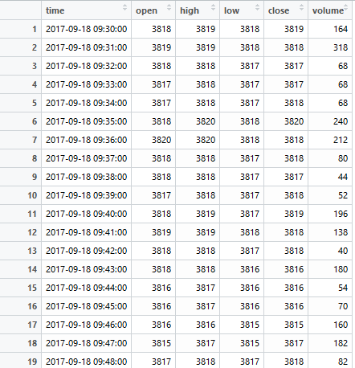
Data Explanation: data_format1
Each element of data_format1 is a dataframe referred to one special future
For example, the left-hand screenshot shows the head part of data_format1[‘AU.SHF’].This dataframe shows the OHLC information about AU.SHF with a timestamp column.
For element names or index, please referred to information.csv

Slide 13
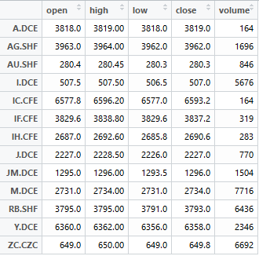
Data Explanation: data_format2
Each element of data_format2 is a dataframe referred to one special minute
For example, the left-hand screenshot shows data_format2[‘2017-09-18 09:30:00’]. From this dataframe, you can get the information such as the open price of AU.SHF at the minute bar 2017-09-18 09:30:00 is 280.4.

Slide 14
Trading Guideline
The initial cash is 10,000,000.
At one minute, your strategy should make decision about longing / shorting different futures next minute, the trading unit must be integer multiple of unit_per_lot in information.csv.
At next minute, if your position of some assets changes, we assume the trading price is always the average price of the asset in this minute. Here average price is calculated by (OPEN+HIGH+LOW+CLOSE)/4
The transaction rate is 0.00005 for each trading action. For example, suppose you decide to long 1 lot (10 units) of A.DCE next minute, and the average price of this asset is 3818 next minute, then your transaction cost will be 3818*10*0.00005 = 1.909. Suppose after 1 hour, the average price turns to 3818.5 and you want to close your position, then you need to pay another 3818.5*10*0.00005 = 1.90925 as the transaction fee.

Slide 15
Trading Guideline
The testing program will check the cash balance of your strategy every minute. Once it finds your current cash balance is less than 100,0000, it will force your strategy to close all positions next minute and stop.
Note that your cash balance will be affected by your margin balance and transaction fee. If your margin balance increases / decreases, your cash balance will decrease / increase by a same amount plus the transaction fee. And your margin balance is affected by your position change and asset price change. For example, suppose your current margin balance is 0 and your strategy decide to long 1000 units of A.DCE next minute, the trading price (average price of next minute bar) is 3818, then your margin balance will increase to 0.07*3818*1000=267260. One minute later, suppose the average price turns to be 3818.5, and your position of this asset is changed from 1000 to -500 (i.e. you close all long position and open a short position). Then your margin balance turns to be 0.07*3818.5*500 = 133647.5. That is, your margin balance will decrease by 133647.5 and your cash balance increases by the same amount (in this example we ignore the transaction fee).

Slide 16
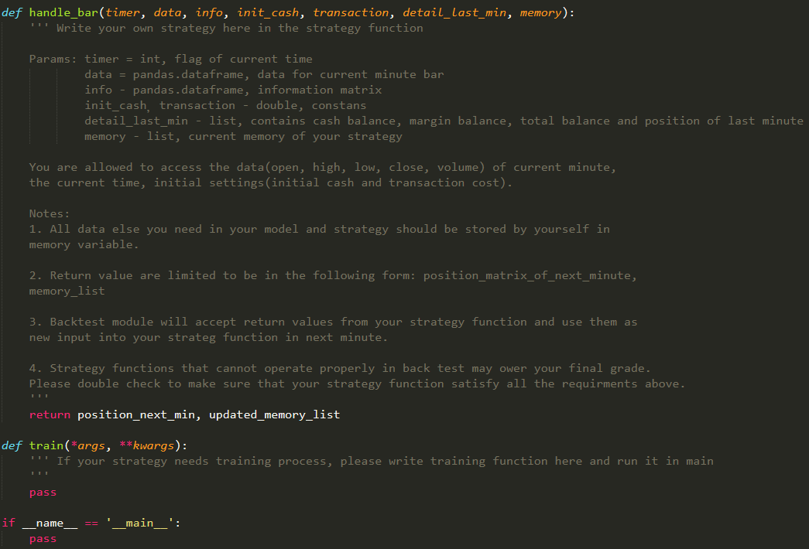
How to write your strategy function?
DO NOT change the input/output parameter names in the strategy functions!

Slide 17
How to write your strategy function?
Basically, your strategy function take the information from some minute bar, along with your current wealth information and try to make decision for your position at next minute bar.
You should make use of the “memory” variable flexibly, since it is a list which will be read and write cyclically during the whole testing period. For example, if you want to calculate the current 5-minute moving average for close price, you should keep the recent 5 close price in your memory list.

Slide 18
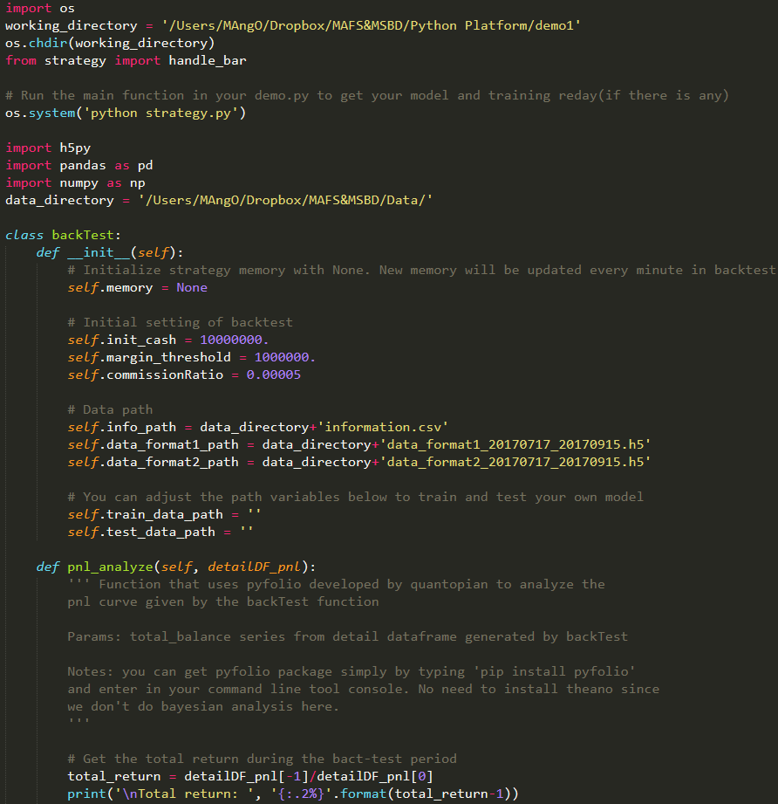
How to test your strategy’s performance?
Before testing, set working folder and data path properly in backTest.py (i.e. the second line in this Python file)
DO NOT modify other parts of bactTest.py
run the whole backTest.py file (you can do it by clicking the Run file(F5) button in Spyder)
Check the results and re-examine your strategy function

Slide 19
Some suggestions
Double check your strategy before upload it to the cloud drive. A strategy that failed to pass backTest.py will not be included in leaderboard that week.
We will test your strategy with the unknown coming data. Keep it in mind that training set ≠ test set
Try not to speculate or gamble extravagantly. Even if you get good performance score by luck, don’t forget the final report counts for 50% of the total marks. Writing down your speculative actions in a rigorous quantitively way is not an easy job

Slide 20
Some suggestions
Install Anaconda/Spyder or other high-end IDE(PyCharm, etc.) for easy coding
Read the demos carefully
Try to do some exploratory analysis firstly before writing your first strategy. Play with data using tools of plots and summary statistics.
Some finance related package, such as pandas, numpy, matplotlib, pyfolio, zipline may be helpful
Try to work together and discuss with your teammates regularly.

